Slide 1
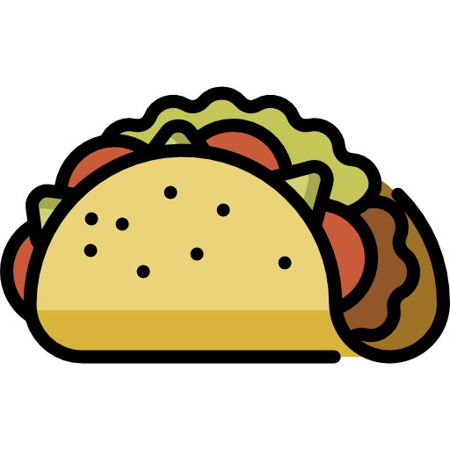
Welcome Back!! We have a lot planned today!
Hello there! Thanks so much for returning back to CompSci Club! September 15 to October 15 marks Hispanic Heritage Month, a celebration of the everlasting impact that Hispanic Americans have had on the culture and history of the U.S. Both tracks, try your hand at the following warmup!
Track Two
Track One
You don’t have to look far to find the massive impact of the Hispanic community than their legacy on food
Create function called make_recipe that allows users to specify an amount of ingredients and saves that to a dictionary
Before the function even runs, you should be able to specify how many times you want the recipes you want and have the program run that money times
Each dictionary should have a name value and then a recipe value that contains a list of all of the ingredients
Try this with some traditional Hispanic recipes from this site!
Make various variables that correspond to some of your favorite Hispanic foods
Make sure to follow proper Python variable naming conventions!
Print each one of these out!
Notes:
https://replit.com/@ArnavSareen/CompSci-Public#main.py

